Slide 1
H.B HARI SHESHATHRI
Final Project
3/21/2024 Annual Review

Slide 2

PROJECT TITLE
PROBABILISTIC RISK ASSESSMENT AND
PREDICTION OF CYBER SECURITY THREATS IN CRITICAL INFRASTRUCTURE
3/21/2024 Annual Review

Slide 3



AGENDA
1.INTRODUCTION
2.METHOLOGY
3.DATA COLLECTION AND PREPARATION
4.PREDICTIVE MODELING
5.RESULT AND ANALYSIS
3/21/2024 Annual Review

Slide 4

PROBLEM STATEMENT
This project aims to address this gap by developing a robust framework for probabilistic risk assessment and prediction of cyber security threats in critical infrastructure. The framework will leverage data-driven approaches to analyze historical cyber incidents, identify vulnerabilities, assess the likelihood and impact of potential threats, and predict future attack scenarios. By incorporating probabilistic modeling techniques, the framework will provide stakeholders with a probabilistic understanding of cyber risks, enabling more informed decision-making and proactive risk management strategies.
Key challenges to be addressed include the complexity and interconnectivity of critical infrastructure systems, the lack of comprehensive and reliable data on cyber incidents, and the need to develop predictive models that can adapt to evolving threats. Additionally, the framework must account for uncertainties inherent in cyber security risk assessment, such as the dynamic nature of cyber threats and the limited availability of data on emerging attack vectors.
3/21/2024 Annual Review

Slide 5

PROJECT OVERVIEW
The primary objective of this project is to develop a comprehensive framework for probabilistic risk assessment and prediction of cyber security threats in critical infrastructure. By integrating probabilistic modeling techniques with advanced predictive analytics, the project aims to enhance the understanding of cyber risks, improve preparedness and response strategies, and ultimately strengthen the resilience of critical infrastructure systems against cyber attacks.
Key Components:
Decision Support System:
Developing a decision support system that synthesizes the results of probabilistic risk assessment and predictive modeling.
Providing stakeholders with actionable insights, risk mitigation strategies, and recommendations for enhancing cyber security resilience in critical infrastructure.
3/21/2024 Annual Review

Slide 6
Validation and Deployment:
Validating the framework through case studies and real-world simulations to assess its effectiveness in predicting cyber security threats.
Facilitating the deployment of the framework within organizations to strengthen their cyber security posture and mitigate potential risks
Collaborating with industry partners and stakeholders to ensure the practical applicability and scalability of the framework across different critical infrastructure sectors.

Slide 7

WHO ARE THE END USERS?
The end users for probabilistic risk assessment and prediction of cybersecurity threats in critical infrastructure are typically stakeholders involved in managing and securing critical infrastructure systems. This includes:
Government Agencies
Such as departments responsible for homeland security, defense, or infrastructure protection.
They utilize risk assessments to inform policy-making, resource allocation, and regulatory frameworks aimed at enhancing cybersecurity in critical infrastructure.
Critical Infrastructure Operators
Entities responsible for operating and maintaining critical infrastructure systems such as energy grids, transportation networks, water supply systems, etc.
They rely on risk assessments to identify vulnerabilities, prioritize mitigation efforts, and allocate resources effectively to safeguard their systems.
3/21/2024 Annual Review

Slide 8
Information Security Professionals
Cybersecurity experts within organizations or consulting firms who specialize in assessing and managing cyber risks.
They use probabilistic risk assessments to identify potential threats, assess their likelihood and potential impact, and develop strategies to mitigate risks effectively.
Risk Management Professionals
Professionals responsible for enterprise risk management within organizations.
They utilize probabilistic risk assessments to understand the overall risk landscape, prioritize risks, and make informed decisions about risk mitigation strategies.
Technology Providers
Companies developing cybersecurity solutions and technologies tailored for critical infrastructure protection.
They may use risk assessments to understand market needs, design effective solutions, and demonstrate the value of their products in mitigating specific cyber threats.
Regulatory Bodies
Organizations responsible for setting standards and regulations related to cybersecurity in critical infrastructure sectors.
They rely on risk assessments to inform the development of regulatory frameworks, compliance requirements, and enforcement strategies aimed at enhancing cybersecurity resilience.

Slide 9

YOUR SOLUTION AND ITS VALUE PROPOSITION
Solution
The solution for probabilistic risk assessment and prediction of cybersecurity threats in critical infrastructure involves leveraging advanced technologies, methodologies, and expertise to accurately assess and predict potential cyber threats and their impact on critical infrastructure systems
Value Proposition
Enhance Risk Awareness: By conducting probabilistic risk assessments, the solution helps stakeholders gain a comprehensive understanding of the cybersecurity risks facing critical infrastructure systems. This includes identifying vulnerabilities, assessing the likelihood of cyber threats, and estimating the potential impact of successful cyberattacks.Prioritize Mitigation Efforts: By quantifying risks in probabilistic terms, the solution enables stakeholders to prioritize mitigation efforts based on their potential impact and cost-effectiveness.
3/21/2024 Annual Review

Slide 10

THE WOW IN YOUR SOLUTION
A "wow factor" solution for probabilistic risk assessment and prediction of cyber security threats in critical infrastructure would involve cutting-edge technologies and innovative approaches to address the unique challenges of protecting critical systems. Here are some elements that might elicit a "wow" factor:
Advanced Machine Learning Algorithms
Integration of Big Data
Real-time Threat Detection
Predictive Analytics
Dynamic Risk Assessment
Simulation and Scenario Analysis
Collaborative Threat Intelligence
Human-Centric Design
Quantitative Risk Metrics
3/21/2024 Annual Review
10

Slide 11
MODELLING
Modeling for probabilistic risk assessment and prediction of cybersecurity threats in critical infrastructure involves several key components and techniques. Here's an outline of the process
Risk Quantification: Quantify the overall risk associated with each cybersecurity threat to critical infrastructure. This involves combining the probability of occurrence with the potential impact to calculate a risk score or rating.
Bayesian Networks: Use Bayesian networks to model the probabilistic relationships between different variables such as threats, vulnerabilities, and impacts. This allows for a holistic view of the cybersecurity risk landscape.
Threat Modeling: Conduct a thorough analysis of potential cybersecurity threats that could target the identified critical assets. This includes understanding the motivations of attackers, their capabilities, and the potential vulnerabilities they might exploit.
Graph-based Models: - Represent the critical infrastructure network as a graph, where nodes represent assets (e.g., servers, routers) and edges represent connections between them. Graph-based models can capture the topology of the infrastructure and simulate the spread of cyber threats through the network.
11
3/21/2024 Anual Review

Slide 12
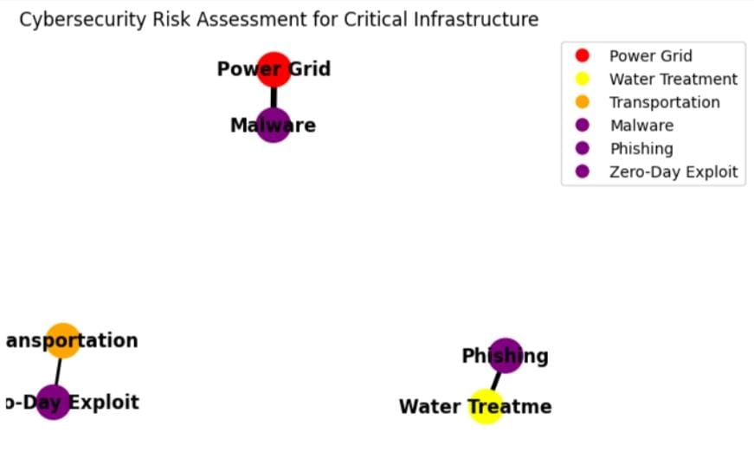
RESULTS
Here's how you can interpret the result:- If the predicted risk probability is closer to 0, it suggests a low likelihood of a cyber security threat impacting the critical infrastructure.- If the predicted risk probability is closer to 1, it indicates a high likelihood of a cyber security threat impacting the critical infrastructure.- The interpretation of the result may vary based on the specific thresholds and risk tolerance levels defined by the organization responsible for managing the critical infrastructure.
Demo Link
3/21/2024 Annual Review
12

